Slide 1

TERMINAL COMMANDS

Slide 2

Terminal
A terminal is a tool to interact with our computer without a graphical interface.
With a terminal, we can do the same things we do with any graphical interface.
Nowadays, every computer has a terminal, even the cloud remote ones.
Knowing how to navigate through the terminal is an essential skill for a developer.
There are many types of terminals, and they depend on the OS of the computer:
  Terminal, iTerm,...
  Cmd, AnacondaPrompt, Powershell,...

Slide 3
Main terminal commands
There are many different terminal commands, but we can classify them in two groups:
Navigate through our system
Handle files and folders
Linux/MacOS users use:
  Terminal/iTerm
Windows users:
  GitBash -> use this one!
  Anaconda prompt
  Anaconda PowerShell

Slide 4
Navigation commands
Knowing the current folder:
  pwd
List the files of the current folder:
  ls
Moving to another folder:
  cd folder
  cd .
  cd ..
  cd ../folder

Slide 5
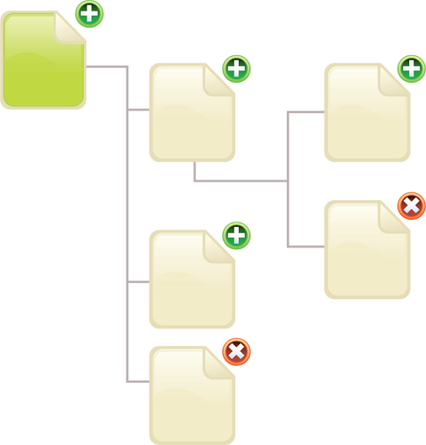
Folder tree
All the folders/directories have a hierarchical structure.
When we want to change to another folder, we can use:
  Absolute path
    Full address of the new path
  Relative path
    Address of the new path with respect to the current folder
Examples:
Absolute: /Users/ignacio/Desktop/IRONHACK/MATERIAL10/
Relative: ../MATERIAL10

Slide 6
Files and folder commands
Creating a new empty file (in the current folder):
  touch filename
Creating a new folder (inside the current one):
  mkdir foldername
Deleting a file:
  rm filename
Deleting a folder:
  rm -rf foldername
We can provide the absolute path or the relative path while creating the file/folder
WHEN USING THE TERMINAL DELETED FILES WILL NOT BE ACCESSIBLE ANYMORE!!!!

Slide 7
Files and folder commands
Creating a copy of a file:
  cp file_old file_new
Moving files (equivalent to rename the file) :
  mv file_old new_file
We can provide the absolute path or the relative path while creating the file/folder

Slide 8
Other useful commands
Knowing the current user:
  whoami
Clear screen:
  clear
Reuse previous commands:
  Use the up/down arrow keys to reuse a previously typed command.

Slide 9
Other useful commands
Pipe operator: |
In the terminal, the output of one command can be send as the input for another one!
  cat file.txt | more
Redirection command “>” allows to send the output to another file:
  echo “Hello” > my_file.txt
Append command “>>” adds the output of the command into the end of a file:
  echo “Hello” >> my_file

Slide 10
Other useful commands
To search for content inside a file, we can use the “grep” command:
  grep “Hello” file.txt

